Slide 1

CS411-Compiler Construction
Lexical Analysis
Talha Waheed, Dept. of CS, UET, Lahore, Pakistan.

Slide 2
Course Learning Objectives

Slide 3
Role of Lexical Analyser

Slide 4
Role of the Lexical Analyzer
Breaks input into tokens for parser
Removes white space (blanks, tabs, newlines) and comments.
Insert user-defined symbols (typically identifiers, function names, const) into symbol table
Simplifies design of grammar into modules (separation of concerns).

Slide 5
Lexical Analyzer
Lexical Analyzer reads the source program character by character to produce tokens.
Normally a lexical analyzer doesn’t return a list of tokens at one shot, it returns a token when the parser asks a token from it.

Slide 6
Lexical Analyzer
source
program
Lexical
Analyzer
token
Parser
GetNextToken()
Symbol
Table

Slide 7
Terminology
Token (Type)
unit of lexical analysis returned to the parser (e.g., num, id, relop)
Lexeme (Word)
the character string representing a particular token
Pattern
description of the lexemes that match a token
Regular expressions are widely used to specify patterns.

Slide 8
Examples

Slide 9
Tokens and Attributes
Since a token can represent more than one lexeme, additional information should be held for that specific lexeme.
This additional information is called as the attribute of the token.
Tokens generally have type and attribute

Slide 10
Tokens and Attributes
Attribute can be value or pointer (or index) into symbol table for entry
<id, “Abc”, 0> 0 is index into symbol table for variable “Abc”
<num, “3.455”, >
<ne, “!=”, >
<id, “B”, 2> 2 is index into symbol table for variable “B”
<if, “if”, >
Token type and its attribute uniquely identifies a lexeme.

Slide 11
Input Buffering

Slide 12
Input Buffering - Lexical Analyzer
Error Handler
source
program
token
Parser
Scanner (Double Buffering)
Lexical Analyzer
GetNextToken()
Symbol
Table
Notes:
Scanner – Double Buffering using Multithreading
How to specify and recognize tokens for a lexical analyzer using Regular Expression, Regular Grammars and Finite Automata.
Then We implemented Lexical Analyzer that are based on Finite Automata by 1) maintaining a State variable, 2) without state variables 3) Transition Table Based and 4) Compressed Transition Table based
Error Handler How to Handle different types of lexical errors using various actions like delete, insert, replace, transpose, we have also implemented panic mode error handling
Removal of White Space and Comments
5 Different Techniques for Keywords Handling, we have implemented hash table based technique

Slide 13
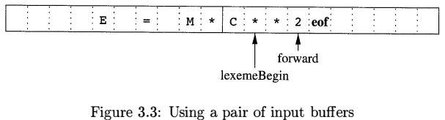
Double Buffering the Input 1/2
Why Double Buffering?
To speed up the scanning from hard drive.
To handle lookahead issues.
(Lookahead for an id? Any non-id character)
Buffer size is N (size of disk block, e.g. 1024 or 4096 bytes)
Use Multithreading
Pointer lexemeBegin marks the beginning of current lexeme, whose extent we are attempting to determine
Pointer forward scans ahead until a pattern match is found.
In the above fig. forward is ahead of ** (exponent operator of fortran)

Slide 14
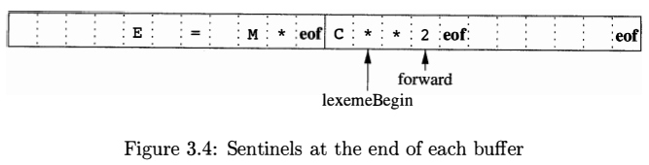
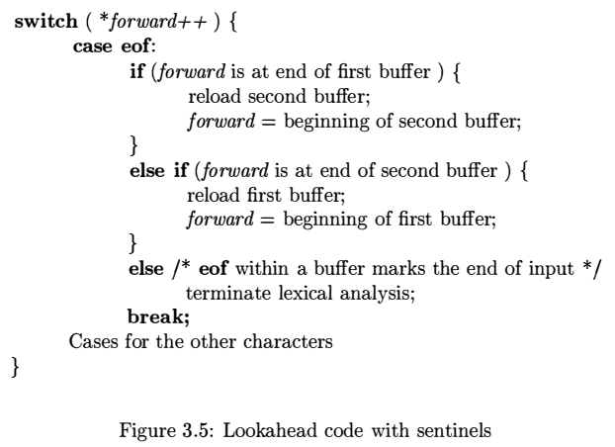
Double Buffering the Input 2/2
Same as fig. 3.3 but with sentinel (eof) added

Slide 15
Lexical Error Handling

Slide 16
Lexical Errors 1/2
Different Types of Errors
Lexeme too long from the specified bound of language
8/32/256 characters limit of identifier length in different versions of C/C++
Number overflow from the bound on precision of numeric constant
from capacity of available storage, if checked by compiler
Unexpected character
non-allowed special characters e.g. $ in id abc$123
fi (7 ^ 2 ) ?
Misspelled words from dictionary “thier” instead of “their” and “quontity” instead of “quantity”.
Unterminated string e.g. “abcd
Show error message along with the following information:
Type of Error/Error Message
Erroneous Lexeme
Line number
Column Position

Slide 17
Lexical Errors 2/2
Panic Mode Error Handling
Successive characters are ignored until we reach a well-formed token/ separator
Automatic Error Recovery
Delete a character e.g. in abc$123
Insert a character e.g. in position := initial + current
Replace a character e.g. in abc$123 to ?
Transpose 2 adjacent characters e.g. 1xab to x1ab
Heuristics
Single character transformation
Minimal number of transformations
Use Historical Statistical Data and choose from highest percentage of probability
Few errors are detectable, because lex has a localized view of source program

Slide 18
Specification of Tokens

Slide 19
Specification of Tokens
To describe/specify tokens of any programming language we use any one:
Regular Expression
Regular Grammar
Regular Definitions (Combination of above two)
Each of them denotes a set of regular language

Slide 20
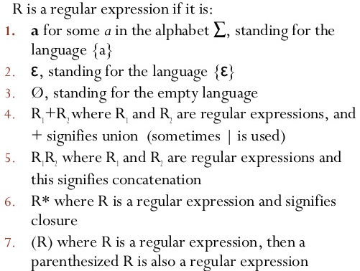
Regular Expressions

Slide 21
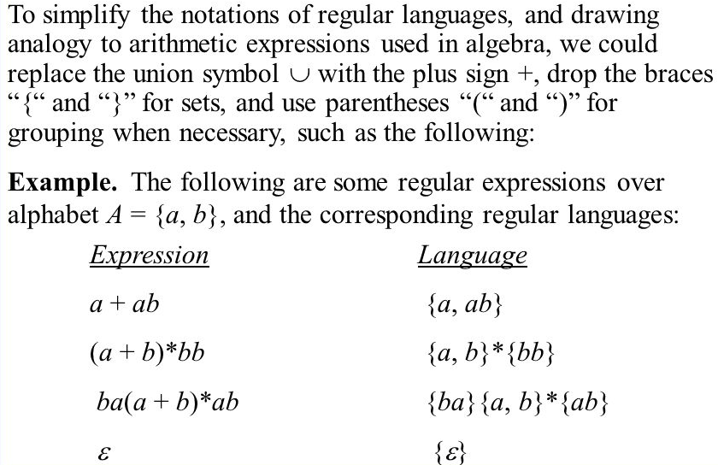
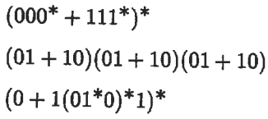
Regular Expressions Examples
Identify the languages of following regular expressions

Slide 22
Regular Grammar
A grammar is regular if its rules are only in any of the following form
A → ɛ
A → a
A → aB where ɛ is a special symbol called NULL
E.g.
S → ɛ | aT | bT T → aS | bS
Identify the language generated by above grammar?
Where its regular expression is (aa+bb+ab+ba)*

Slide 23
Regular Definitions
Writing regular expression for some languages can be difficult, because their regular expressions can be quite complex.
In those cases, we may use regular definitions, that is more compact and combines best features of regular expressions and regular grammar.
We can give names to regular expressions, and we can use these names as symbols to define other regular expressions.

Slide 24
Regular Definitions (cont.)
Example 1: Identifiers in Pascal
(start) id → letter (letter | digit ) *
letter → A | B | ... | Z | a | b | ... | z
digit → 0 | 1 | ... | 9
If we try to write the regular expression representing identifiers without using regular definitions, that regular expression will be complex.
(A|...|Z|a|...|z) ( (A|...|Z|a|...|z) | (0|...|9) ) *

Slide 25
Regular Definitions – Example Unsigned Numbers
(start) unsigned-num → digits opt-fraction opt-exponent
digits → digit⁺
digit → 0 | 1 | ... | 9
opt-fraction → [ . digits ]?
opt-exponent → [ E [+|-]? digits ]?
Regular Expression
(0 + .. + 9) ⁺ +
(0 + .. + 9)⁺.(0 + .. + 9) ⁺ +
(0 + .. + 9)⁺ E (‘+’ + ‘-’ + ɛ ) (0 + .. + 9)⁺ +
(0 + .. + 9)⁺.(0 + .. + 9) ⁺ E (‘+’ + ‘-’ + ɛ ) (0 + .. + 9)⁺
Or
(0 + .. + 9)⁺ (ɛ + .(0 + .. + 9) ⁺) (ɛ + E (‘+’ + ‘-’ + ɛ ) (0 + .. + 9)⁺)

Slide 26
Shorthand Notations
(a) ⁺ denotes one or more instance
r* = r ⁺ | ε
r ⁺ = rr*
(r)? denotes zero or one instance
r? = r | ε
[a-z] denotes choice between a | b | c | .. | z

Slide 27
3 More Compact Examples
[a-zA-Z] ⁺ denotes string of one or more characters
[a-zA-Z][a-zA-Z0-9] * denotes set of all valid identifiers in Fortran
where its Regular expression is (A + B + .. + z) (A + B + .. + z + 0 + .. + 9)*
[0-9] ⁺ (.[0-9] ⁺)? (E (+|-)? [0-9] ⁺)? denotes set of all valid unsigned Pascal numbers

Slide 28
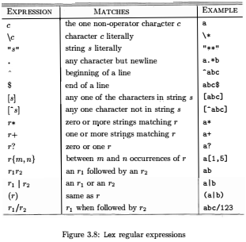
Use of Regular Expressions in
regex,
grep,
windows search,
google search,
in email specification,
in URL specification.

Slide 29
Recognition of Tokens

Slide 30
Token Recognizers
We already learned how to specify tokens using regular expressions (or regular definitions).
Now, we study how to recognize the tokens using Finite Automata (or its variants).
That can be used to implement lexical analyzer (in various ways)

Slide 31
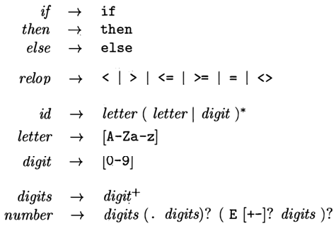
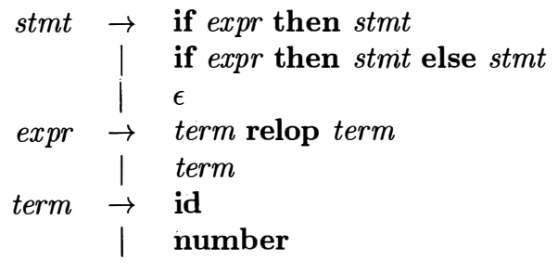
Some Regular Definitions in a Pascal CFG
CFG
Note:
relop for equal is “=” and not equal is “<>”
Terminals are : if, then, else, id, number
Here Keywords are reserve words
Regular Definitions

Slide 32
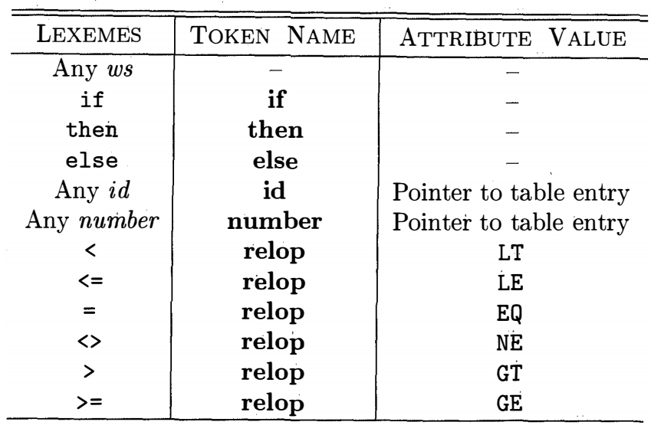
Goal for Lexical Analyzer
Tokens, their patterns and Attribute value for each lexeme
For this goal, we need to define Finite Automata (FA) as a recognizer.
First, we define/get regular expressions for tokens
Then we convert them into FA to implement a lexical analyzer for tokens of our language.

Slide 33
Finite Automata As a Token Recognizer
A recognizer for a language is a program that takes an input string x, and answers “yes” if x is a sentence of that language, and “no” otherwise.
A finite automaton can be:
Deterministic (DFA) or Non-deterministic (NFA), or a Transition Table
we may use DFA, NFA or Transition Table as a lexical analyzer.

Slide 34
DFA vs NFA
Both DFA and NFA recognize regular languages.
Deterministic Finite Automata
Faster
but it may take more memory space
have no chance of error
Widely used for Lexical Analyzers of small languages.
Non-deterministic Finite Automata
Slower, may require input checking multiple times
but it may take less memory space,

Slide 35
Deterministic Finite Automaton (DFA)
A DFA is a special form of NFA. where
no state has ε-transition
for each symbol a and state s, there is exactly one labeled edge a leaving s (so no confusion).

Slide 36
Transition Diagrams (a loosely defined DFA)
b
a
a
0
a
1
b
2
b
The language recognized by this DFA is?
Regular Expression (a+b)*ab
As an intermediate step in construction of a lexical analyzer, we convert regular expression into transition diagrams (of FA’s).
A Finite Automata (Informal Definition) have a
1) a set of alphabets and
2) a set of states,
3) with one starting state, and
4) one or more accepting states
5) where each edge is labeled by characters causing transitions

Slide 37
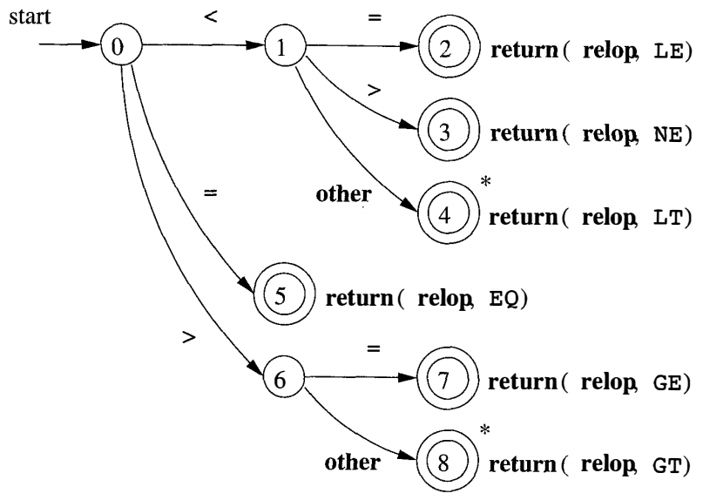
Transition Diagrams (DFA) for Relational Operators of Pascal
Regular definition of relop
Here * represents ungetchar() function, to put back the extra character that was read from the next token.
What tokens will be generated for the Input “>== <abc <>” ?
0➔6➔7 (return relop, GE)
0 ➔5 (return relop, EQ)
0➔1➔4 (return relop, LT)
error
0➔1➔3 (return relop, NE)

Slide 38
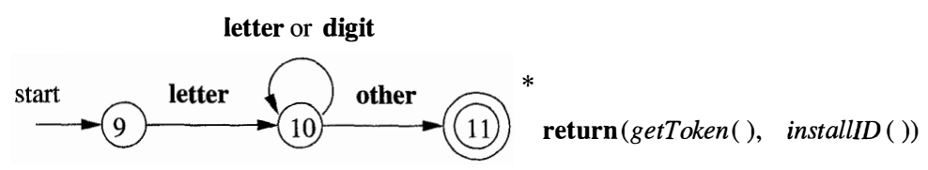

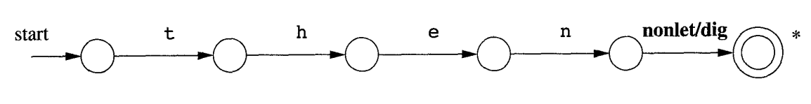
Transition Diagrams for Identifiers (and keywords) of Pascal
Regular definition of id is given in box
getToken() will return the token if it already exists in symbol table
installID() adds a new token in symbol table.
Reserve Word Handling by Transition Diagrams
A transition diagram of reserve word “then” is given below
What token is generated if it process “the” instead of “then”?

Slide 39
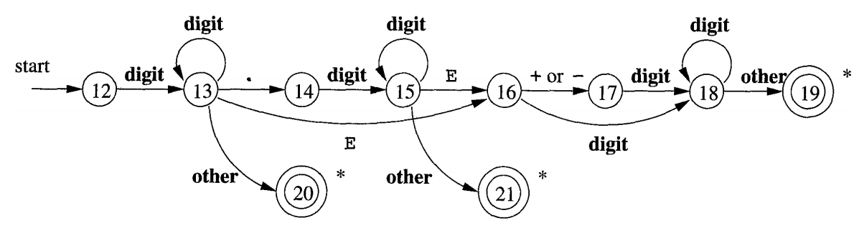
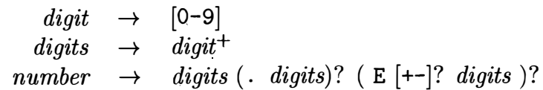
Transition Diagrams for Numbers of Pascal
State 20 for Integer numbers, if separately handled
State 21 for Floating point numbers, if separately handled
State 19 for Scientific Numbers, if separately handled
For all of these we can return (number, “lexeme of number”)
Regular definition of numbers is given in the box:

Slide 40
White Space Handling in Lexical Analyzer
White space (ws) can be inserted freely between lexical tokens
Lexical Analyzer strips off the white spaces by recognizing the token ws as defined by the following grammar rule.
Abstract symbols of blank, tab and newline represents ASCII characters
It is different from other tokens, when we recognize the ws we do not return it to the parser. We just ignore it and process next significant char.

Slide 41
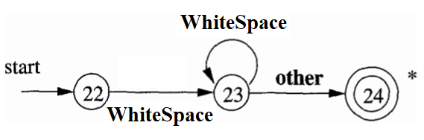
Transition Diagram for White Space
WhiteSpace is any white space character (blank, tab or newline).
No token will be generated.

Slide 42
Implementation of Lex

Slide 43
Approaches for Lex Implementation
State Variable Based Implementation
State-less Implementation
Transition Table Based Implementation
Compressed Transition Table Based

Slide 44
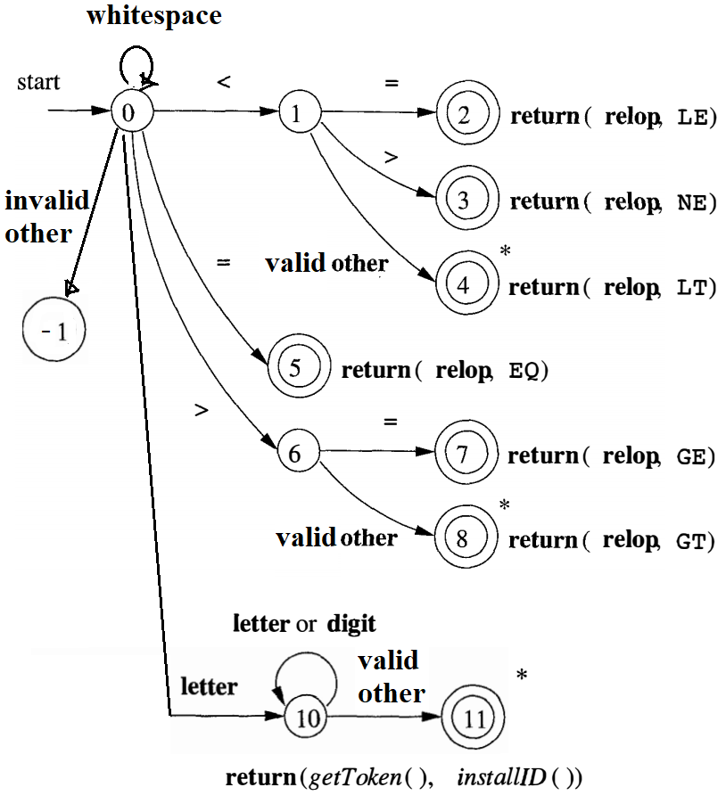
Token GetNextToken()
{ while(1){
switch (state) {
case 0: ch=GetNextChar();
if (IsWhiteSpace(ch))
{ state = 0; lexemeStart++;}
else if (ch == ‘<’) {state = 1;}
else if (ch == ‘=’) {state = 5;}
else if (ch == ‘>’) {state = 6;}
else if (IsLetter(ch)) {state = 10;}
else {state = fail();}
break;8
case 1: ch = GetNextChar();
if (ch == ‘=’) {state = 2;}
else if (ch == ‘>’) {state = 3;}
else if (IsSeparator(ch)) {state = 4;}
else {state = fail();} break;
case 2: return (relop, LE);
case 3: return (relop, NE);
case 4: return (relop, LT);
case 5: return (relop, EQ);
… /* cases 6-8 Here */
case 10: ch = GetNextChar();
if (IsLetter(ch) || IsDigit(ch)) {state = 10;}
else {state = 11; }
break;
case 11:UnGetChar(1);InstallID(); return(GetToken()); // ID }
State-Variable Based Implementation

Slide 45
Token GetNextToken()
{
while(1) { ch = GetNextChar();
if (IsWhiteSpace(ch)) //Space
{ while (IsWhiteSpace(ch)) {ch = GetNextChar();} }
else if (ch == ‘<’) {ch = GetNextChar();
if (ch == '=') return (relop, LE);
else if (ch == '>) return (relop, NE);
else if (IsSeparator(ch)) {UnGetChar(1); return (relop, LT);
else fail();}
else if (ch == ‘=’) {return (relop, EQ);}
else if (ch == ‘>’) {ch = GetNextChar();
if (ch == '=') return (relop, GE);
else if (IsSeparator(ch)) {UnGetChar(1);
return (relop, GT);}
else fail();}
else if (IsLetter(ch)) {ch = GetNextChar();
while (IsLetter(ch) || IsDigit(ch))
{ ch = GetNextChar(); }
if (IsSeparator(ch)) {UnGetChar(1); InstallID(); return(GetToken());} //ID
else fail();}
}
Stateless Lexical Implementation

Slide 46
Stateless vs State Variable Based Lexical Implementation
Token GetNextToken()
{
while(1) { ch = GetNextChar();
if (IsWhiteSpace(ch)) //Space
{ while (IsWhiteSpace(ch)) {ch = GetNextChar();} }
else if (ch == ‘<’) {ch = GetNextChar();
if (ch == '=') return (relop, LE);
else if (ch == '>) return (relop, NE);
else if (IsSeparator(ch)) {UnGetChar(1);
return (relop, LT);
else fail();}
else if (ch == ‘=’) {return (relop, EQ);}
else if (ch == ‘>’) {ch = GetNextChar();
if (ch == '=') return (relop, GE);
else if (IsSeparator(ch)) {UnGetChar(1);
return (relop, GT);}
else fail();}
else if (IsLetter(ch)) {ch = GetNextChar();
while (IsLetter(ch) || IsDigit(ch))
{ ch = GetNextChar(); }
if (IsSeparator(ch)) {UnGetChar(1);
InstallID(); return(GetToken());} //ID
else fail();}
}
Token GetNextToken()
{ while(1){
switch (state) {
case 0: ch=GetNextChar();
if (IsWhiteSpace(ch))
{ state = 0; lexemeStart++;}
else if (ch == ‘<’) {state = 1;}
else if (ch == ‘=’) {state = 5;}
else if (ch == ‘>’) {state = 6;}
else if (IsLetter(ch)) {state = 10;}
else {state = fail();}
break;
case 1: ch = GetNextChar();
if (ch == ‘=’) {state = 2;}
else if (ch == ‘>’) {state = 3;}
else if (IsSeparator(ch)) {state = 4;}
else {state = fail();} break;
case 2: return (relop, LE);
case 3: return (relop, NE);
case 4: return (relop, LT);
case 5: return (relop, EQ);
… /* cases 6-8 Here */
case 10: ch = GetNextChar();
if (IsLetter(ch) || IsDigit(ch)) {state = 10;}
else {state = 11; } break;
case 11:UnGetChar(1);InstallID(); return(GetToken()); //ID }

Slide 47
Transition Table based Implementation
State | Token | < | = | > | A | B | .. | Z | 0 | .. | 9 | Space | T ab | New line | $
0 | -1 | 1 | 5 | 6 | 10 | 10 | 10 | 10 |  |  |  | 0 | 0 | 0 | -1
1 | -1 | 4 | 2 | 3 | 4 | 4 | 4 | 4 | 4 | 4 | 4 | 4 | 4 | 4 | -1
2 | LE |  |  |  |  |  |  |  |  |  |  |  |  |  | -1
3 | NE |  |  |  |  |  |  |  |  |  |  |  |  |  | -1
4 | LT |  |  |  |  |  |  |  |  |  |  |  |  |  | -1
5 | EQ |  |  |  |  |  |  |  |  |  |  |  |  |  | -1
6 | -1 | 8 | 7 | 8 | 8 | 8 | 8 | 8 | 8 | 8 | 8 | 8 | 8 | 8 | -1
7 | GE |  |  |  |  |  |  |  |  |  |  |  |  |  | -1
8 | GT |  |  |  |  |  |  |  |  |  |  |  |  |  | -1
9 | -1 |  |  |  |  |  |  |  |  |  |  |  |  |  | -1
10 | -1 | 11 | 11 | 11 | 10 | 10 | 10 | 10 | 10 | 10 | 10 | 11 | 11 | 11 | -1
11 | ID
Dry run for Input: abc123 > $

Slide 48
Transition Table based Implementation
State | Token | < | = | > | A | B | .. | Z | 0 | .. | 9 | Space | T ab | New line | $
0 | -1 | 1 | 5 | 6 | 10 | 10 | 10 | 10 |  |  |  | 0 | 0 | 0 | -1
1 | -1 | 4 | 2 | 3 | 4 | 4 | 4 | 4 | 4 | 4 | 4 | 4 | 4 | 4 | -1
2 | LE |  |  |  |  |  |  |  |  |  |  |  |  |  | -1
3 | NE |  |  |  |  |  |  |  |  |  |  |  |  |  | -1
4 | LT |  |  |  |  |  |  |  |  |  |  |  |  |  | -1
5 | EQ |  |  |  |  |  |  |  |  |  |  |  |  |  | -1
6 | -1 | 8 | 7 | 8 | 8 | 8 | 8 | 8 | 8 | 8 | 8 | 8 | 8 | 8 | -1
7 | GE |  |  |  |  |  |  |  |  |  |  |  |  |  | -1
8 | GT |  |  |  |  |  |  |  |  |  |  |  |  |  | -1
9 | -1 |  |  |  |  |  |  |  |  |  |  |  |  |  | -1
10 | -1 | 11 | 11 | 11 | 10 | 10 | 10 | 10 | 10 | 10 | 10 | 11 | 11 | 11 | -1
11 | ID
Token GetNextToken()
{
int TransitionTable[NoOfStates][NoOfChars];
// Populate Table values from csv file
int State = 0;
int row = 0, col = 0;
while (State != -1) // -1 is Error
{
char ch = GetNextChar();
col = GetColumnIndex(ch);
State = TransitionTable[State+1][col];
if (TransitionTable[State+1][1] == IsToken)
{ return (TransitionTable[State+1][1]); }
} //end while
ErrorHandler();
} // end function

Slide 49
Issues in Implementing a Lexical Analyzer
How to map states on rows and characters on columns?
States have direct mapping on rows, by adding some offset e.g.
state 0 can be mapped on row 2, state 1 can be mapped on row 3. So row = state+2.
For mapping characters on columns we may use
A linear Search, O(n)
A Binary Search, O(log n)
A Balanced Tree, O(log n)
A Hash Function, O(1)
A map, hashmap from STL, O(1)
ASCII code mapping, O(1)

Slide 50
Issues in Implementing a Lexical Analyzer
Lex GetNextToken() function can return a struct/object with attributes E.g. <ID, “abc123”, 3, (5, 12) >
tokenConstant
lexeme
Pointer or index to symbol table entry
Position (line, column) of the token in the input file (for error handling)
What is the difference between a struct and an object?
Assume some maximum lexeme length
const int MAXLENGTH = 50; // any appropriate value

Slide 51
Issues in Implementing a Lexical Analyzer
All tokens can be encoded as integer constants
Which one to choose and why? define, constant or enumerations.
#define ADDOP 100
#define MULOP 101
#define RELOP 102
#define ASSIGNOP 103
#define WHITESPACE 104
#define ID 105
#define NUMBER 106
#define BEGIN 107
#define END 108
#define IF 109
#define THEN 110
#define WHILE 111
…
#define EOFILE 1000
#define ERROR -1
const ADDOP = 100;
const MULOP = 101;
const RELOP = 102;
const ASSIGNOP = 103;
const WHITESPACE = 104;
const ID = 105;
const NUMBER = 106;
const BEGIN = 107;
const END = 108;
const IF = 109;
const THEN = 110;
const WHILE = 111;
…
const EOFILE = 1000;
const ERROR = -1;
enum TokensConst {
ADDOP = 100,
MULOP = 101,
RELOP = 102,
ASSIGNOP = 103,
WHITESPACE = 104,
ID = 105,
NUMBER=106,
BEGIN = 107,
END = 108,
IF = 109,
THEN = 110,
WHILE = 111,
…
EOFILE = 1000
ERROR = -1};

Slide 52
Issues in Implementing a Lexical Analyzer
The order in which tokens are recognized is not particularly important in lex.
Issue: How to mark the end of a token? Is there a single separator for all tokens?
Separators in a language syntax are normally not defined.
Characters that are not allowed in identifier definition can mark the end of token. e.g. white space between ID and GT in “abc123 >” or operator in “abc123>”
it is not feasible nor sensible to rely on the existence of white space only to separate all tokens. Or to make white space compulsory as a separator. It creates issues??
Solution:
Maintain a list of valid separators for different types of tokens.
We may need a look-ahead character for decision
No issue, if number of characters in a token are fixed. e.g. + (ADDOP) is a single length token
What to produce for “>=“?
two tokens (GT, EQ) or single token (GE)
Solution: In this case, the lex has to recognize the longest possible string.

Slide 53
Comments Handling in Lexical Analyzer
Different languages provide different syntax for comments
e.g. C++ provides single-line (//) and multiline comments (/*…*/), Pascal comments are enclosed in {comments}, etc.
Comments are meant for the programmer, not for compiler.
Normally comments are skipped by lex, and the next token (which is not a comment) is returned to the parser.
Comments may be useful for semantic compilers implementation.
So they don’t complicate the syntax analysis of the language.
Binary Listing Program{0, 1, 00, 01, 10, 11, 000, 001, 010, 011, …}
Binary Listing Program{C₀, C₁, C₂, C_{3,} C_{4,} C_{5,} C_{6,} C_{7,} C_{8,} C_{9,} …}
Recognizer Program = {C₅₈₅=hello world, C₉₁₈₅=arithmetic calc, C₁₈₁₇₈₅=pubg game, …}

Slide 54
Single Character Tokens
switch (ch) {
case ’;’: lextoken = SEMICOLON;ch = getchar(); break;
case ’,’: lextoken = COMMA; ch = getchar(); break;
case ’+’: lextoken = ADDOP; ch = getchar(); break;
case ’-’: lextoken = MINUSOP; ch = getchar(); break;
case ’/’: lextoken = DIVOP; ch = getchar(); break;
case ’*’: lextoken = MULOP; ch = getchar(); break;
…
case EOF: lextoken = EOFILE; break;
}
ch = getchar(); // to maintain the one character lookahead before exiting from the lex function.
Other Short Tokens
switch(ch){
case ’<’: ch = getchar(); if (ch==’=’) { lextoken = LE; ch = getchar(); } else lextoken = LT; break;
case ’>’: ch = getchar(); if (ch==’=’) { lextoken = GE; ch = getchar(); } else lextoken = GT; break;
…
}

Slide 55
Integers Handling
if (isdigit(ch))
{
unsigned long token.intval = 0;
while (isdigit(ch))
{
if (i < MAXLENGTH)
{token.lexeme[i++] = ch;}
token.intval = token.intval*10 + ch - ’0’; // overflow ??
ch = getchar();
}
token.lexeme[i] = ’\0’;
token.lextoken = INTNUM;
}

Slide 56
String Handling
if (ch == DOUBLEQUOTE)
{
int i = 0;
while (ch != DOUBLEQUOTE)
{
if (i < MAXLENGTH)
{token.lexeme[i++] = ch;}
ch = getchar();
}
token.lexeme[i] = ’\0’;
token.lextoken = STRING;
}

Slide 57
Identifiers Handling
if (isalpha(ch))
{
int i = 0;
while (ialpha(ch) || isdigit(ch)) {
if (i < MAXLENGTH)
token.lexeme[i++] = ch;
ch = getchar();
}
token.lexeme[i] = ’\0’;
token.lextoken = ID; // if keywords are not distinguished
}

Slide 58
Key Words Handling
If key words are not reserved (what is the difference bw them), then the lex must distinguish between a keyword and a user defined identifier.
e.g. in PL/1 keywords are not reserved, thus the rules for distinguishing keywords from identifiers are quite complicated.
IF THEN THEN THEN = ELSE; ELSE ELSE = THEN;
They can be handled in multiple ways
1) String Matching
if (strcmp(lexeme,"else")==0) lextoken = ELSE;
else if (strcmp(lexeme,"if")==0) lextoken = IF;
…
else if (strcmp(lexeme,"while")==0) lextoken = WHILE;
else lextoken = ID;
2) Add a separate Finite Automata for each keyword, as shown below in a fig.
3) Pre-populate key words into symbol table, and it will return the individual token of each. Internal data structure of symbol table is itself an issue.
4) Handle them in Parser. int a = 0; match (tokens) id1 id2 AssignOp Num Terminator
5) Make a Hash table or use stl map, hashmap
6) Maintain a dictionary / balanced tree data structure

Slide 59
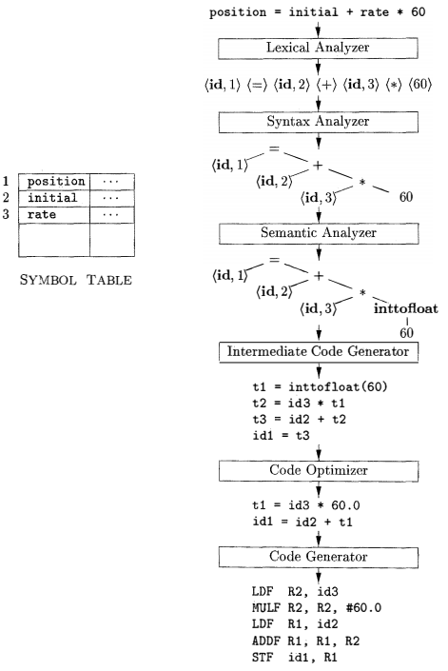
Symbol Table Manager
Analysis collects information about the source and stores it in symbol table (a data structure), which is passed along with the intermediate representation to the synthesis part.
That constructs the target program from the intermediate representation and the information in the symbol table.
So the Information from the symbol-table entry is needed for semantic analysis and code generation.

Slide 60
Symbol Table Manager
The symbol table is a data structure containing a record for each variable name, with fields for the attributes of the name. The data structure should be designed to allow the compiler to find the record for each name quickly and to store or retrieve data from that record quickly.
The attribute value, if present, is a pointer to the symbol table that contains additional information about the token.
The semantic analyzer uses the syntax tree and the information in the symbol table to check the source program for semantic consistency with the language definition. It also gathers type information and saves it in either the syntax tree or the symbol table, for subsequent use during intermediate-code generation

Slide 62
Symbol Table Interface with Lexical Analyzer
symbol table stores some information about tokens (at least lexeme of identifiers, its token constant, index, etc)
how to save the information about variable, const, function, array, class etc in a same symbol table?
e.g. 2D array, hash table – open addressing, chaining
what kind of operations are required?
token Add(token) (done only once)
To put new tokens into the symbol table, and return its object or index
Token Search(lexeme) (required many times, it should be fast )
Return the token of an existing lexeme or -1 if not found.

Slide 63
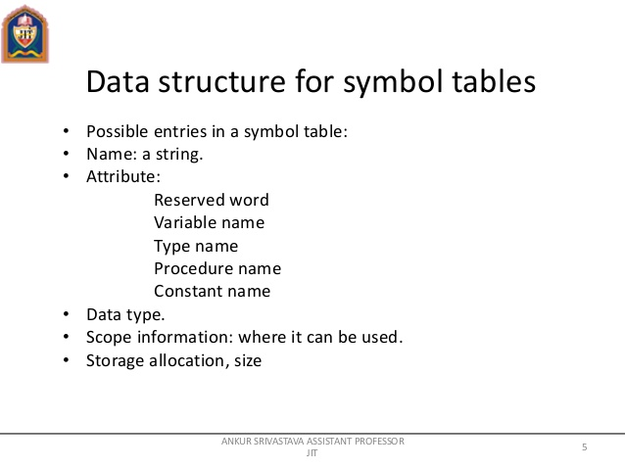
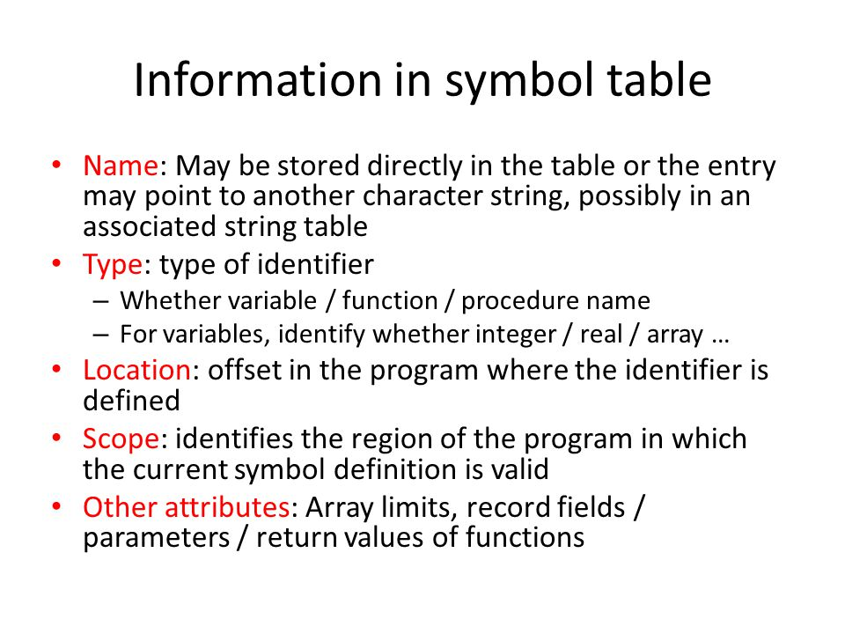
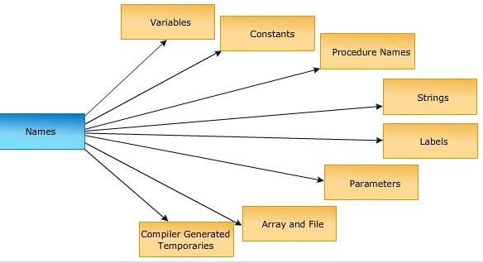

Slide 65
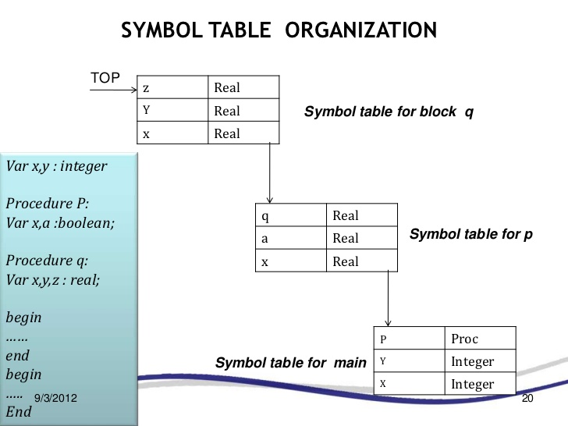

Slide 66
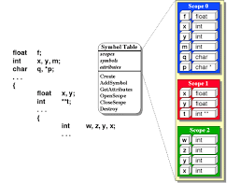

Slide 67
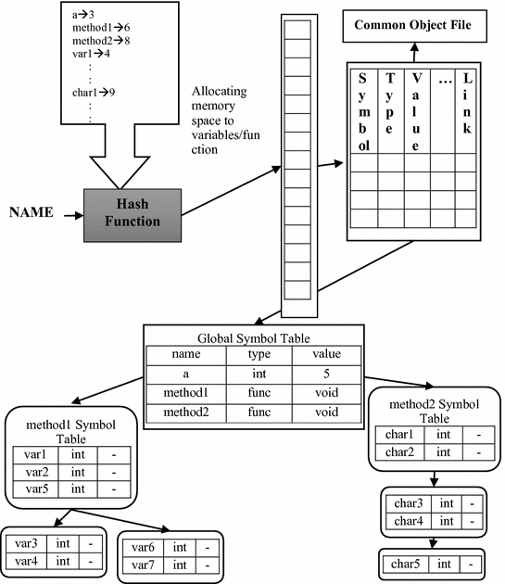

Slide 68
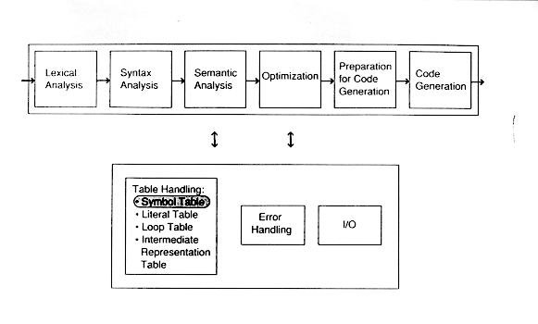
https://web.cs.wpi.edu/~kal/courses/cs4533/module5/myst.html
https://www.slideshare.net/Tech_MX/symbol-table-design-compiler-construction

Slide 69
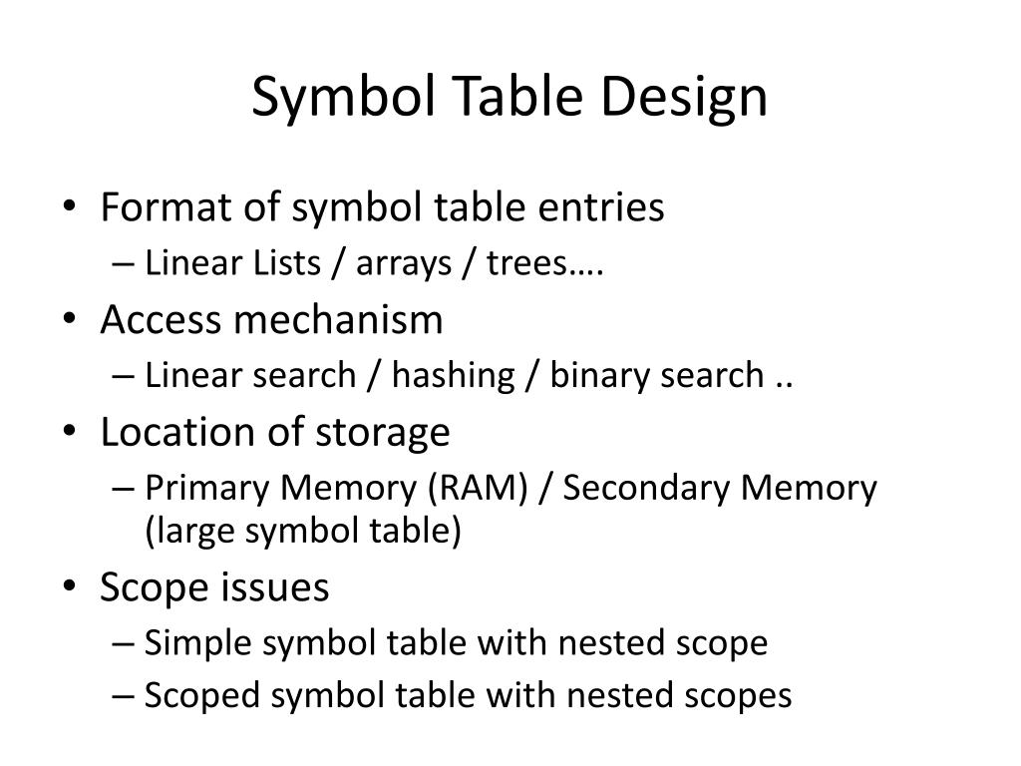
https://www.slideserve.com/enoch/symbol-table

